Slide 1
Progress Meeting

Slide 2
Timeline
Phase I [Mid-evaluation (Jan 20) ]
Literature survey
Experiment design
Observations
Phase II [March]
Algorithm I design (KTI -> Metrics)
Algorithm II design (Metrics -> Diagnosis)
Phase III [April]
Results
Conclusion
Phase IV [April]
Thesis writeup

Slide 3
Current system design

Slide 4
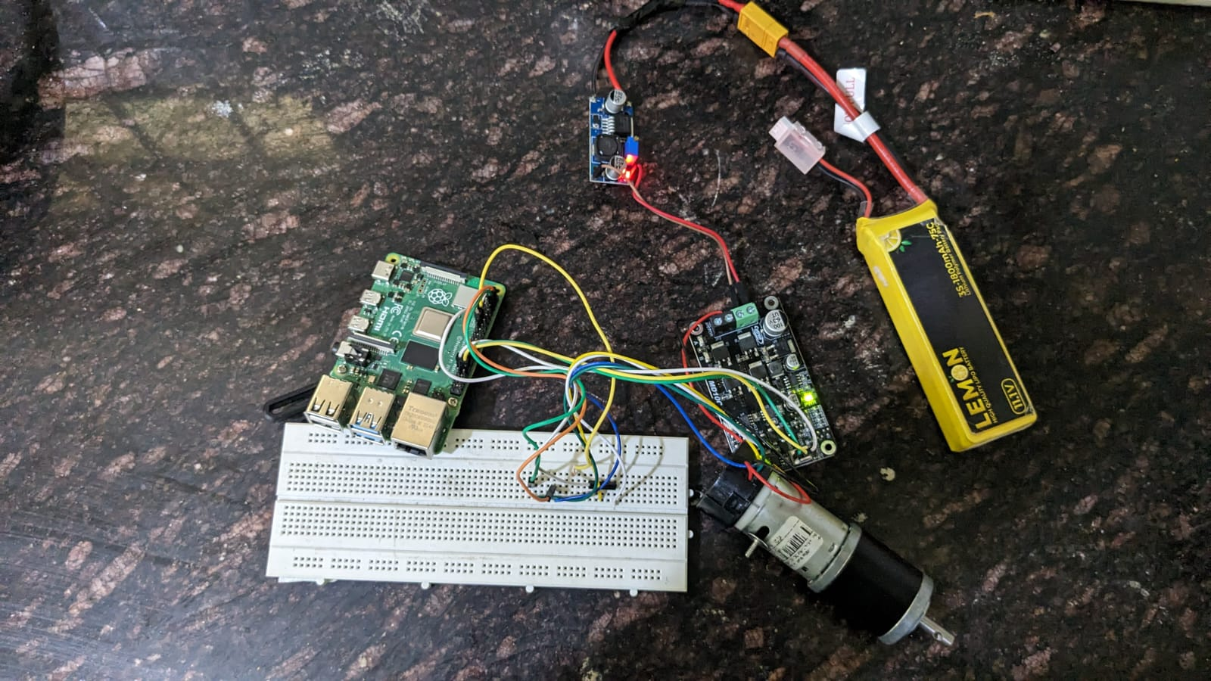
Battery
11.1V
11.1V supply
Buck
5V supply
Motor
RHINO 60RPM 40KGCM 12V DC PLANETARY GEARED QUAD ENCODER MOTOR
Rpi
Motor driver
MD 10C R3
PWM,
DIR
Feedback from encoder

Slide 6
System Design - II

Slide 7
Battery
11.1V
11.1V supply
Buck
5V supply
Motor
RHINO 60RPM 40KGCM 12V DC PLANETARY GEARED QUAD ENCODER SERVO MOTOR
Publish motor control command and receive encoder information
PWM,
DIR
Motor driver
MD 10C R3
Rpi
esp32
Feedback from encoder

Slide 8
Data to be collected
CPU usage of Rpi
Information from esp32 {Network activity, commands received and published}
Memory usage of Rpi
Network activity of Rpi
Command given to motor from pi
Information received from esp32
Temperature of the esp32, Rpi, motor

Slide 9
Safety KTI -- concept
Cybersecurity KTI -- concept

